Slide 1

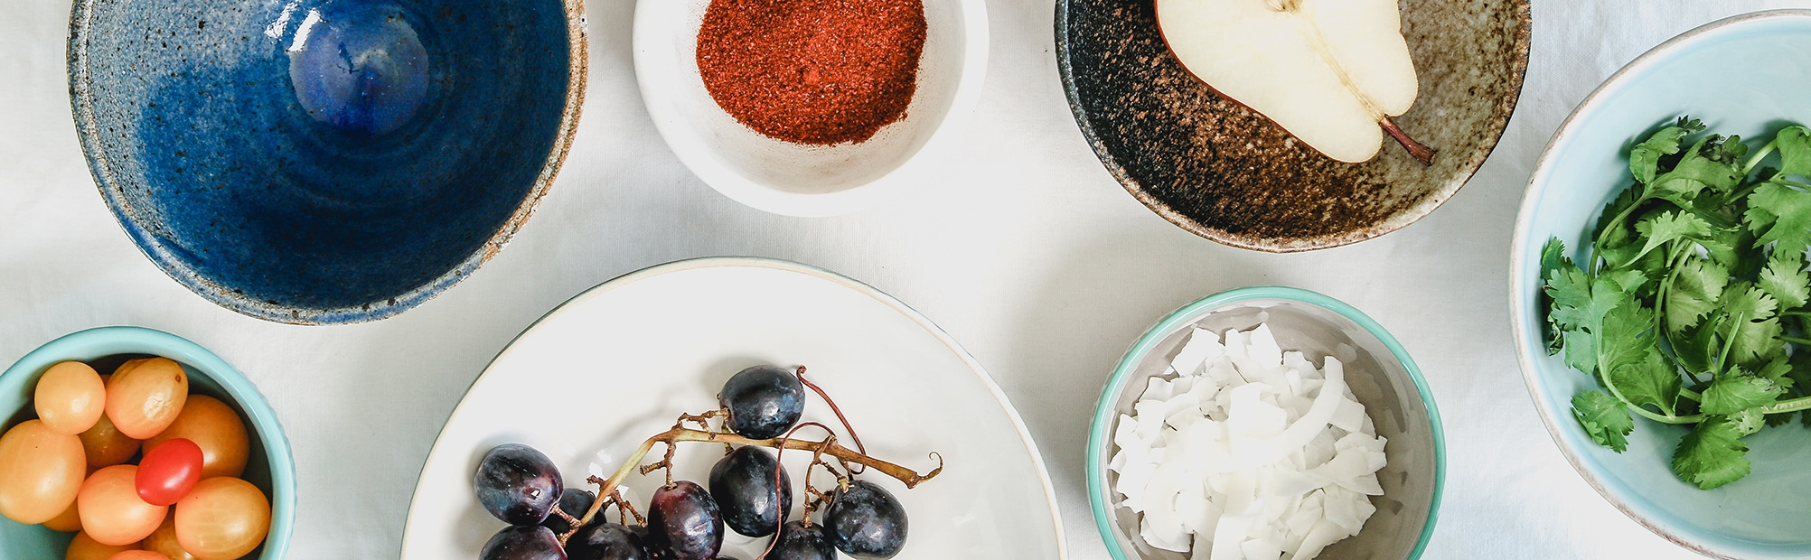
A look back:
Two Years of Worldwide Sales
By Andi Osika

Slide 2
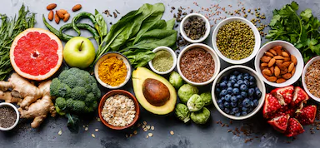

Maximizing Revenue:
Questions to be answered….
Do discount levels effect
quantity ordered?
Do some
Product Categories
Regions
Sales Staff
generate more revenue than others?
%
$
$
$
Sales/Order Data
April 2012 – June 2014
Notes:
Worldwide Provisioner Of Fine Foods
77 products,
8 Categories
9 Sales Staff serving 9 Regions Globally
830 orders
2155 line items
Average prices ~$26.00
Average Qty 24

Slide 3

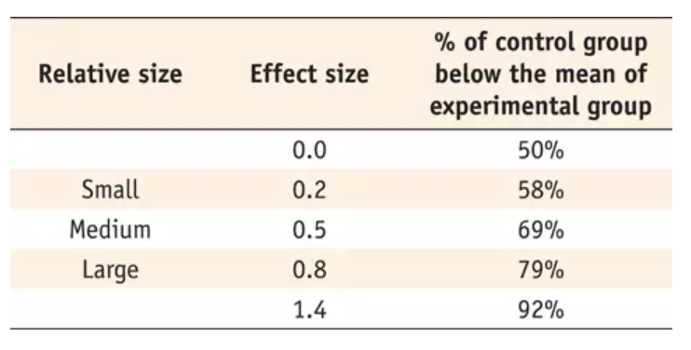
Hypothesis Testing: Methodology
Looking for “significant” differences in sample groups by comparing averages.
Two main measures:
A ‘p-value’ <.05 indicates statistical significance.
* = <.05
** = <.01
*** = <.001
No ‘*’= not significant
(Kruskal-Wallis)
Effect Size / Relative size
(Tukey Test)
Results……
Notes:
Kurskal-Wallis
Compares two or more independent samples of equal or different sample sizes using medians to see if there is a statistically significant interaction.
A non-parametric method*
*Does not assume a normal distribution of the residuals

Slide 4
Discount Levels:
1
Question:
Does discount amount have a statically significant effect on the quantity of a product in an order?
&
If so at what level(s) of a discount(s)?

Slide 5
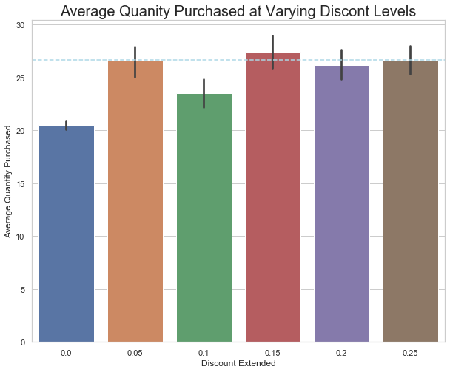
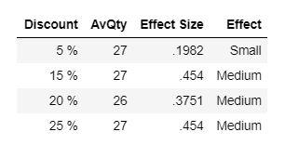
Q: Do Discount Levels Effect Qty?
A: Yes
***
***
***
***
Avg. Qty.= 23
Statistically Equal
P-Value of .001 in comparison to no discount
Recommendation:
Since the effects of higher discounts are equal to lower in terms of quantity purchased, offer the lower discounts - specifically 5% and 15% more frequently when extending any discounts to preserve profit margins.
* Low **Medium *** High Statistical Significance
Notes:
Average qty purchased is 23
Additional notes: For discounts 1%,2%,3%,4%, and 6% that were included in the original dataset, the amount of data provided was relatively small to evaluate the impact on the whole. This data was removed from further testing
There are 1297 samples in the 0.0 discount group. Avg qty 21
The following had adjusted p-values of .001
There are 155 samples in the 0.15 discount group. Av qty 27
There are 182 samples in the 0.05 discount group. Av qty 27
There are 159 samples in the 0.2 discount group. Av qty 26
There are 151 samples in the 0.25 discount group. Av qty 27
There are 170 samples in the 0.1 discount group. Avt qty 24

Slide 6
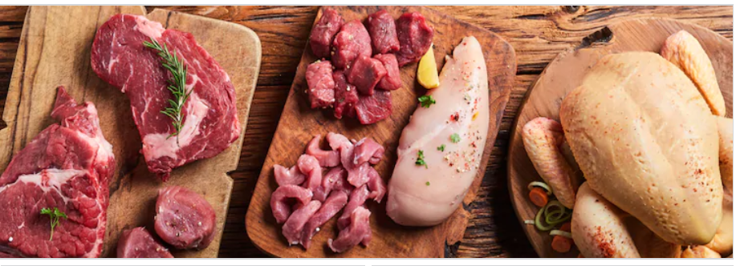
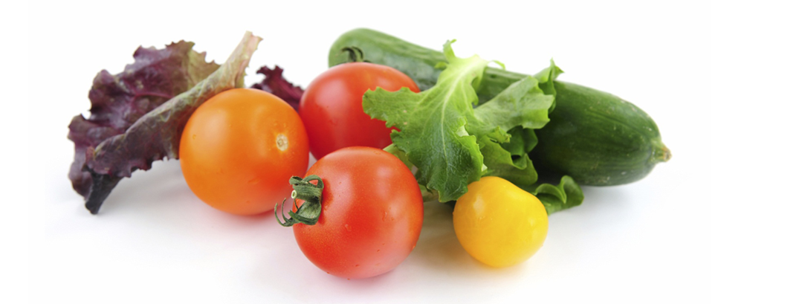
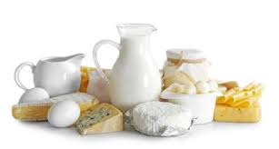
Product Categories:
2
Question:
Do some product categories generate more revenue than others?
$
$

Slide 7
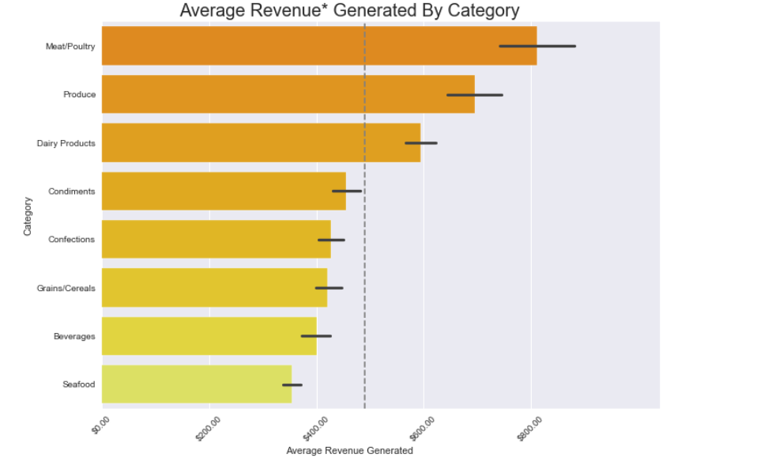
Q: Do some product Categories generate more?
A: Yes
Top
Three
Performers†
Meat/Poultry
Produce
&
Dairy
P-Value .001 ***
***
*** Top three product categories vs bottom five
Top 3
Recommendations:
Maximize revenues with additional products that align with the higher revenue generating categories.
Minimize product offerings in lesser generating categories
*Revenue is calculated by multiplying sales price and quantity, taking into account discounts.† See Appendix for additional detail..
Notes:
The average revenue for Meat/Poultry is $810.81, 6 products
The average revenue for Produce is $695.87, 5 products
P-value of Meat/Poultry and Produce comparison is 0.5359 with a mean diff of -114.
The average revenue for Dairy Products is $593.86 , 10 products
The average revenue for Grains/Cereals is $421.17 , 7 products
The average revenue for Seafood is $353.61 , 12 products
The average revenue for Condiments is $455.54 , 12 products
The average revenue for Confections is $426.83 , 13 products
The average revenue for Beverages is $399.77 , 12 products

Slide 8
Region:
3
Question:
Do certain regions generate more revenue than others?
&
Who are the top three?

Slide 9
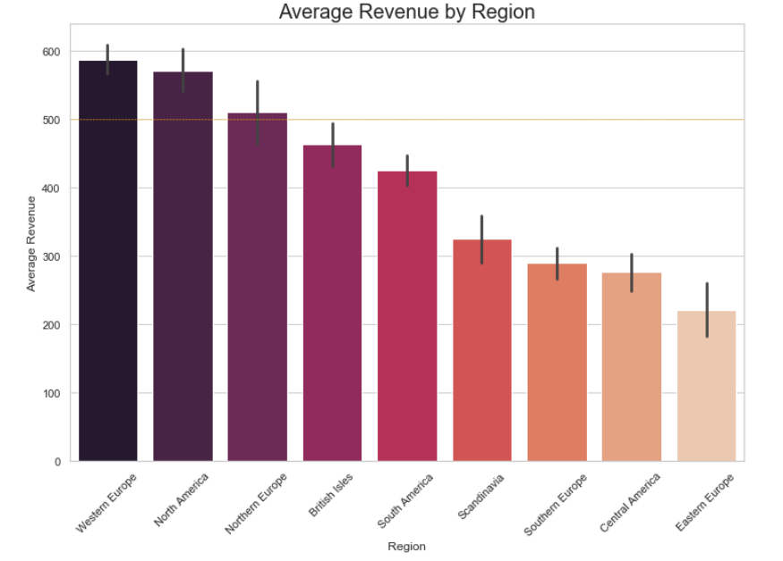
Q:Do some regions generate more?
A:Yes
Western Europe, North America
…. and
Northern Europe
Small sample sizes from Eastern Europe,
Scandinavia, Central America** †
***
**
Avg. Rev = $500
* Low **Medium *** High Statistical Significance
Recommendation:
Explore best practices from regions that are top performers via additional market analysis.
Additional analysis on underdeveloped regions (apply categorical and discount knowledge)
*** Top 3 Performers vs bottom 5†
Add nutritional information
†See additional information in Appendix
Notes:
Average spend across all data was $500.
There are 734 samples in the data set for Regions #Western Europe.
There are 353 samples in the data set for Regions #South America.
There are 71 samples in the data set for Regions #Central America.
There are 418 samples in the data set for Regions #North America.
There are 141 samples in the data set for Regions #Northern Europe.
There are 69 samples in the data set for Regions #Scandinavia.
There are 134 samples in the data set for Regions #Southern Europe.
There are 186 samples in the data set for Regions #British Isles.
There are 16 samples in the data set for Regions #Eastern Europe.

Slide 10
Sales Staff:
4
Question:
Do some sales representatives generate more revenue than others ?
&
Who are the top sellers?
$
$
$
$
$
?

Slide 11
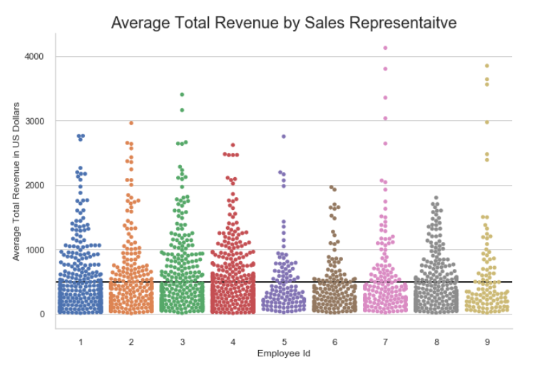
Q:Do some regions generate more?
A:No.
All sales staff, regardless of location or title statistically generate equal revenue.
Recommendation:
Build on knowledge of smaller discounts achieving larger quantities.
Develop regional markets (via analysis - future work?)
Add time and number of servings
Average revenue across all sales staff:
$
$
$
$495
Notes:
Employee information is as follows:
Id LastName FirstName Title Region
Davolio Nancy Sales Representative North America
Fuller Andrew Vice President, Sales North America
Leverling Janet Sales Representative North America
Peacock Margaret Sales Representative North America
Buchanan Steven Sales Manager British Isles
Suyama Michael Sales Representative British Isles
King Robert Sales Representative British Isles
Callahan Laura Inside Sales Coordinator North America
Dodsworth Anne Sales Representative British Isles

Slide 12
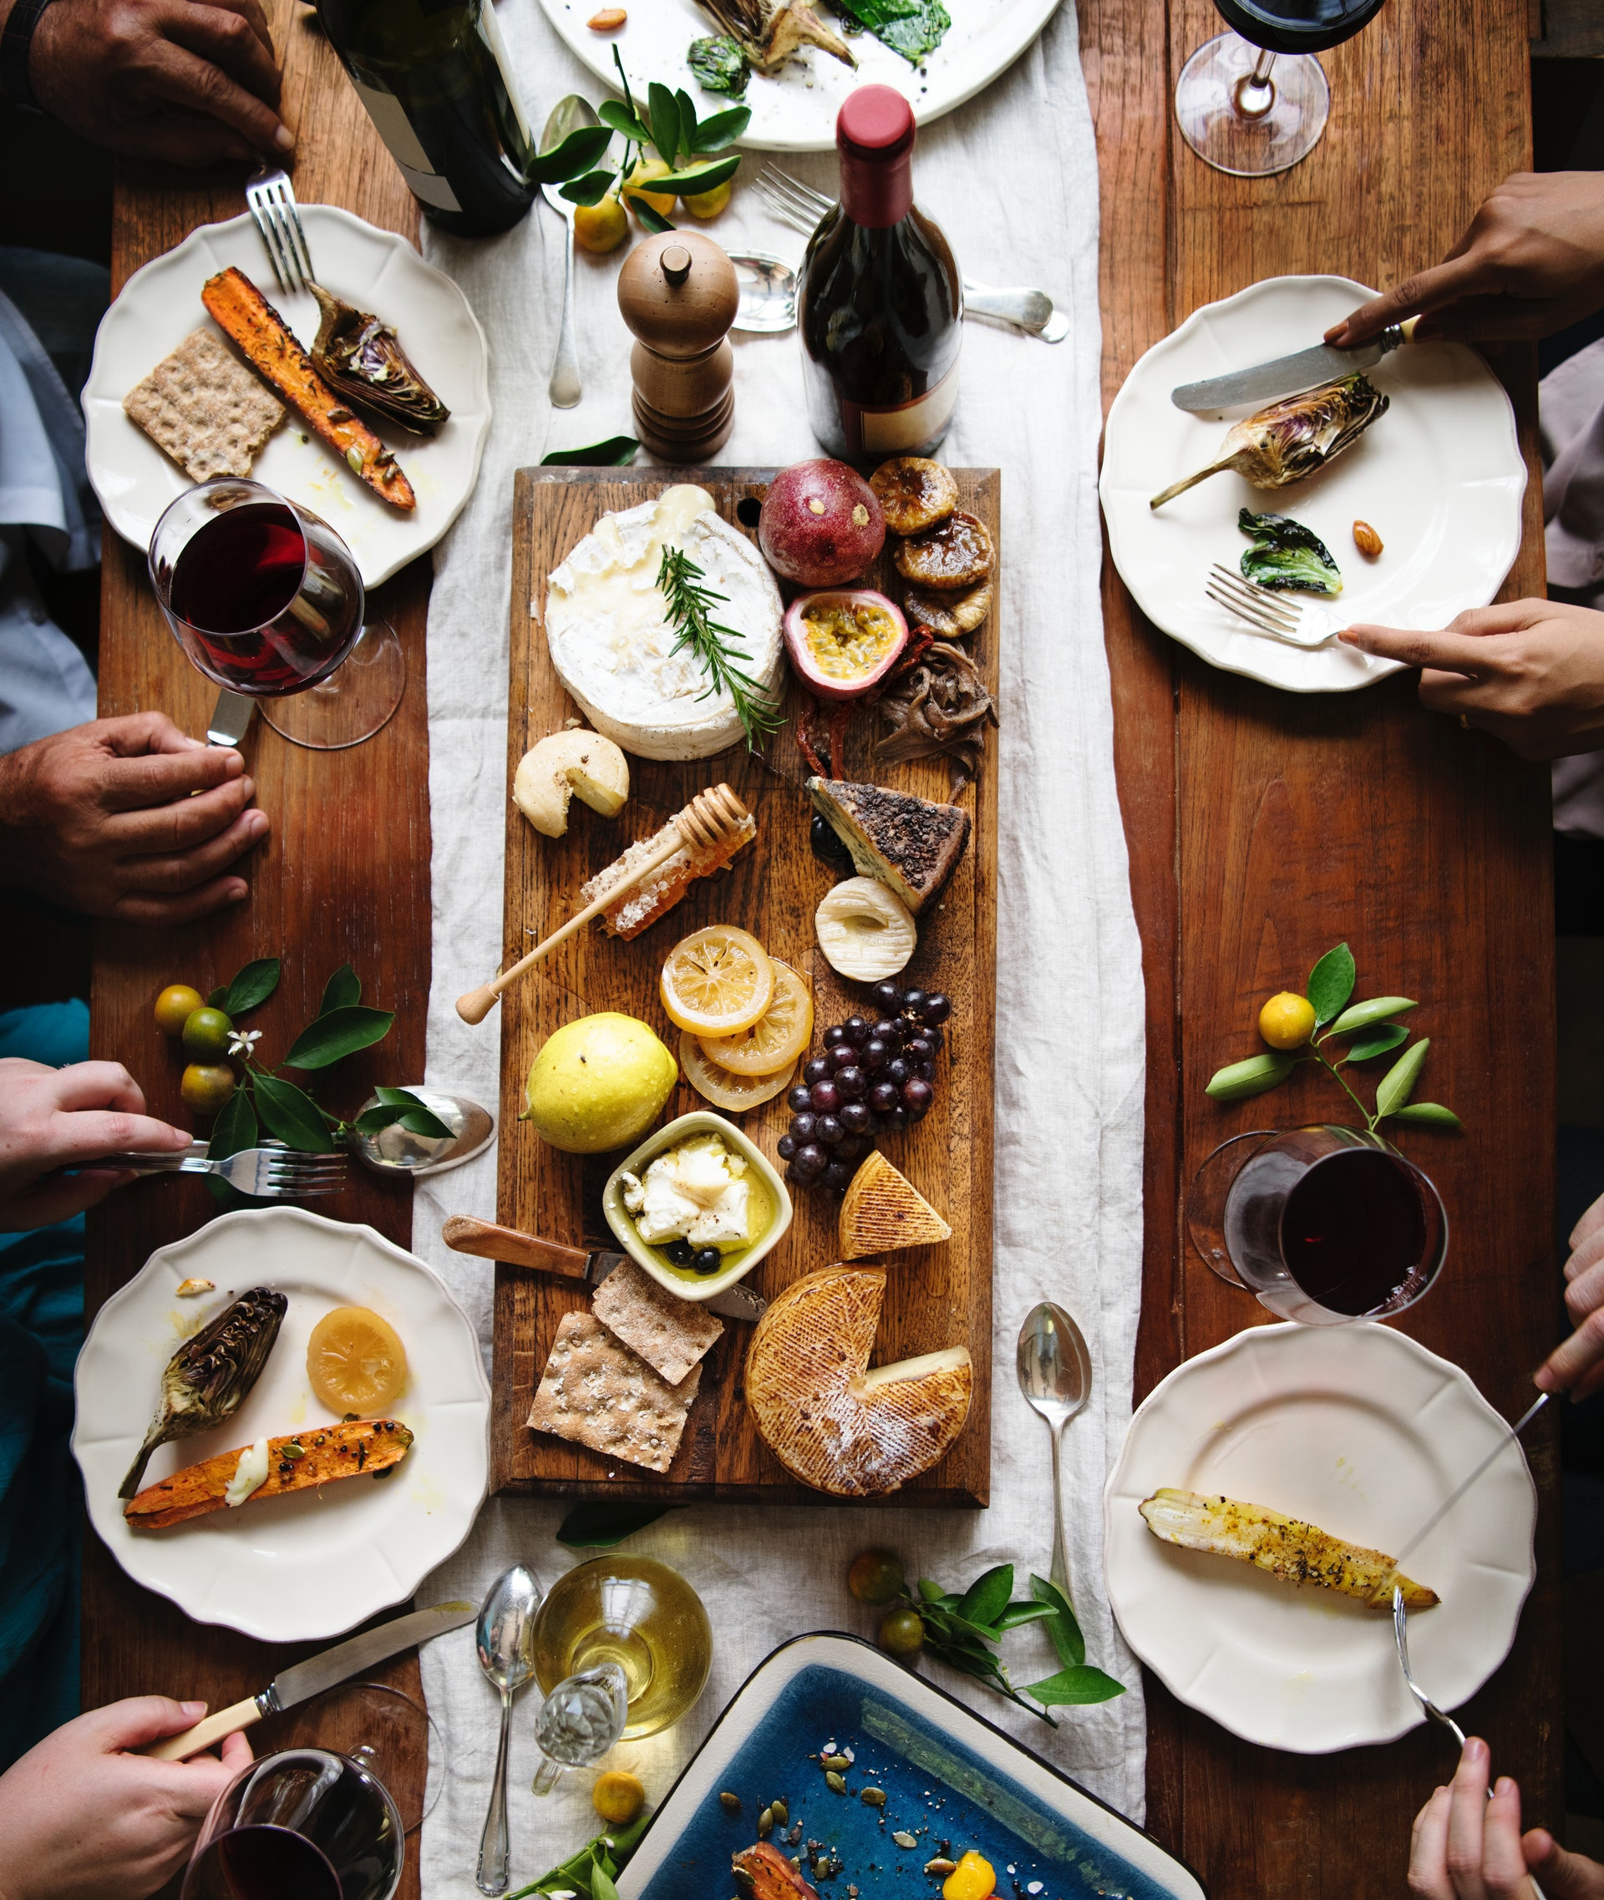
What next?
Maximize Revenues
Offer discounts 5% and 15% more frequently to preserve profit margins.
Refine product categories offerings – expand those that generate higher revenues and cut those who are lacking.
Examine best practices in regions that generate the most revenue and analyze underdeveloped markets.
Use discovered insight to inform and develop sales staff.
Future Work:
Market analysis for regions that need to be developed.
Examples:
Regional category refinement
Discount types and frequency
Sales relationships

Slide 13

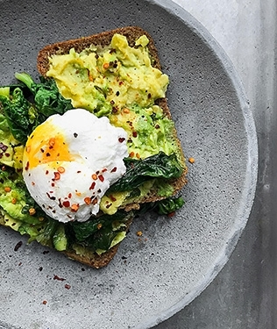

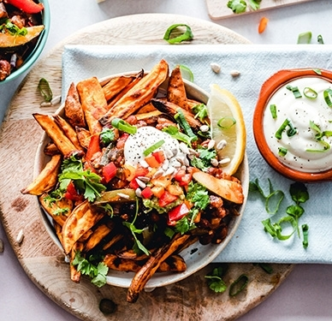
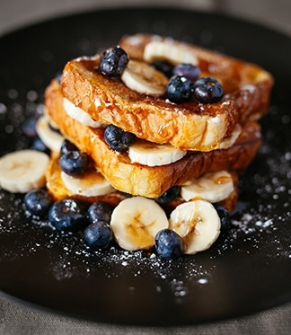

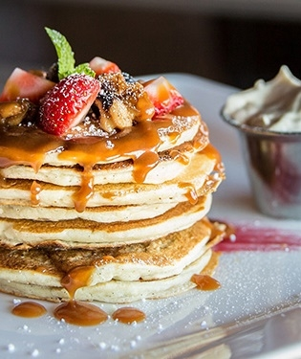
Title Here
Thank You.

Slide 14
Appendix:

Slide 15
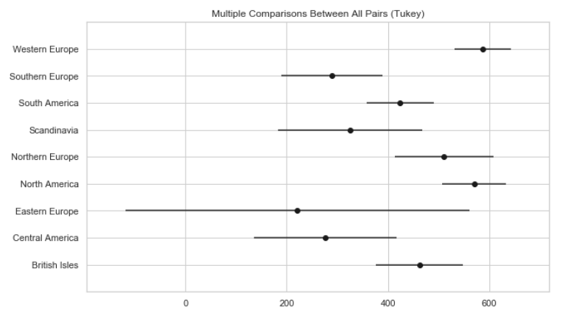
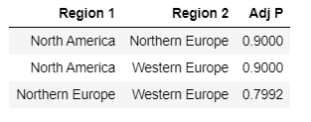
Region:
Appendix materials
Illustrates the difference in confidence intervals of
Tukey test. Some regions that visibly look like they out perform others demonstrate equality here this might be attributed to varying sample sizes.
Group 1 | Group 2 | P-Adj
Central America | North America | 0.001
North America | Scandinavia | 0.012
North America | South America | 0.005
North America | Southern Europe | 0.001
Northern Europe | Southern Europe | 0.016
Central America | Western Europe | 0.001
Scandinavia | Western Europe | 0.003
South America | Western Europe | 0.001
Southern Europe | Western Europe | 0.001
N. & W. Europe, N. America
Statistically Equal Performance

Slide 16
Categories:
Appendix Materials:
Statistically
Equal
Group 1 | Group 2 | Adj - P | Effect | Reject Null Hypothesis: True
Beverages | Dairy Products | 0.001 | 0.352
Condiments | Dairy Products | 0.045 | 0.277
Confections | Dairy Products | 0.001 | 0.341
Dairy Products | Grains/Cereals | 0.005 | 0.350
Beverages | Meat/Poultry | 0.001 | 0.596
Condiments | Meat/Poultry | 0.001 | 0.517
Confections | Meat/Poultry | 0.001 | 0.600
Dairy Products | Meat/Poultry | 0.001 | 0.311
Grains/Cereals | Meat/Poultry | 0.001 | 0.564
Beverages | Produce | 0.001 | 0.521
Condiments | Produce | 0.001 | 0.490
Confections | Produce | 0.001 | 0.560
Grains/Cereals | Produce | 0.001 | 0.571
Dairy Products | Seafood | 0.001 | 0.525
Meat/Poultry | Seafood | 0.001 | 0.755
Produce | Seafood | 0.001 | 0.798
Group 1 | Group 2 | MeanDiff | Adj - P | Reject Null Hypothesis: False
Beverages | Condiments | 55.7712 | 0.9
Beverages | Confections | 27.0669 | 0.9
Beverages | Grains/Cereals | 21.4034 | 0.9
Beverages | Seafood | -46.1557 | 0.9
Condiments | Confections | -28.7043 | 0.9
Condiments | Grains/Cereals | -34.3678 | 0.9
Condiments | Seafood | -101.927 | 0.3439
Confections | Grains/Cereals | -5.6635 | 0.9
Confections | Seafood | -73.2226 | 0.6099
Dairy Products | Produce | 102.0142 | 0.5181
Grains/Cereals | Seafood | -67.5591 | 0.831
Meat/Poultry | Produce | -114.9365 | 0.5359
Significant
Performers
*Revenue is calculated by multiplying sales price and quantity, taking into account discounts.
Notes:
The average revenue for Meat/Poultry is $810.81, 6 products
The average revenue for Produce is $695.87, 5 products
P-value of Meat/Poultry and Produce comparison is 0.5359 with a mean diff of -114.
The average revenue for Dairy Products is $593.86 , 10 products
The average revenue for Grains/Cereals is $421.17 , 7 products
The average revenue for Seafood is $353.61 , 12 products
The average revenue for Condiments is $455.54 , 12 products
The average revenue for Confections is $426.83 , 13 products
The average revenue for Beverages is $399.77 , 12 products

Slide 17
Background:
Worldwide Provisioner
Of Fine Foods
77 products, 8 Categories
9 Sales Staff serving 9 Regions Globally
Notes:
2 years,
830 orders
2155 line items
Average prices ~$26.00
Average Qty 24
Average Sales Staff Revenue $495

